Slide 1
ESC101: Introduction to Computing
Operators and Expressions

Slide 2
Binary Operations
Operate on int, float, double (and char)
Op | Meaning | Example | Remarks
+ | Addition | 9+2 is 11
 |  | 9.1+2.0 is 11.1
- | Subtraction | 9-2 is 7
 |  | 9.1-2.0 is 7.1
* | Multiplication | 9*2 is 18
 |  | 9.1*2.0 is 18.2
/ | Division | 9/2 is 4 | Integer div.
 |  | 9.1/2.0 is 4.55 | Real div.
% | Remainder | 9%2 is 1 | Only for int

Slide 3
Unary Operators
Operators that take only one argument (or operand)
-5
+3.0123
-b
Observe that + and – have two purposes
Meaning depends on context
This is called overloading

Slide 4
The / operator
When both (left and right) operand of / are of type int
The result is the integral part of the real division
The result is of type int
Examples
9/4 is 2
1/2 is 0

Slide 5
The / operator
When at least one (left or right or both) operands of / are of type float (double)
The result is the real division
The result is of type float (double)
Examples
9/4.0 is 2.25
1.0/2 is 0.5,
so is 1/2.0
and 1.0/2.0

Slide 6
The % operator
The remainder operator % returns the integer remainder of the result of dividing its first operand by its second.
Both operands must be integers.
Defined only for integers (int and long)
4%2 is 0
31%4 is 3

Slide 7
Divison(/) and Remainder(%)
Second argument can not be 0
Run time error
For integers a and b (b≠0), / and % have the following relation
a = (a/b)*b + (a%b)
If a or b or both are negative, the result of / and % is system dependent.
But satisfies the above relation

Slide 8



Program Example
Volume of a cone = $\frac{1}{3}×π×radius^{2}×height$
float r,h;
scanf("%f", &r);
scanf("%f", &h);
printf("Volume is %.1f.",
1/3*3.14*r*r*h);
Where did my ice cream go?
Input:
10.0
3.0
Output?
0.0
1/3 evaluates to 0
1.0/3.0 evaluates to 0.3333…
Remember: use floats for real division

Slide 9
Type of Arithmetic Expr
Type of (result of) arithmetic expr depends on its arguments
Rule of thumb:
For binary operator
If both operands are int, the result is int
If one or both operands are float, the result is float
For unary operator
Type of result is same as operand type

Slide 10
Operator Precedence
More than one operator in an expression
Evaluation is based on precedence
Parenthesis (…) have the highest precedence
Precedence order for some common operators coming next

Slide 11
Operator Precedence
Operators | Description | Associativity
(unary) + - | Unary plus/minus | Right to left
* / % | Multiply, divide, remainder | Left to right
+ - | Add, subtract | Left to right
< > >= <= | less, greater comparison | Left to right
== != | Equal, not equal | Left to right
= | Assignment | Right to left
HIGH
INCREASING
LOW

Slide 12

Operator Precedence
-32
What is the value assigned to x?
x = -5*4/2*3+-1*2;
Always use parenthesis to define precedence. It is safer and easier to read.
Avoid relying on operator precedence. Can give absurd results if not used correctly.
Consult any textbook to know more about precedence.

Slide 13
Type Conversion (Type casting)
Converting values of one type to other.
Example: int to float and float to int (also applies to other types)
Can be implicit or explicit
int k =5;
float x = k; // implicit conversion, x gets 5.0
// value of k is not changed.
float y = k/10; // y is assigned 0.0
// WHY?
float z = ((float) k)/10; // Explicit conversion
// z is assigned 0.5

Slide 14
Loss of Information!
Type conversion may result in loss information.
Larger sized type (e.g. float ) converted to smaller sized type (e.g. int) is undefined.
Smaller sized type (e.g. int) converted to larger sized type (e.g. float) may also give unexpected results. Take care!

Slide 15
float to int: type conversion (result ok)
float x;
…
(int) x;
converts the real value stored in x into an integer. Can be used anywhere an int can.
#include<stdio.h>
int main() {
float x; int y; /* define two variables */
x = 5.67;
y = (int) x; /* convert float to int */
printf(“%d”, y);
return 0;
}
Output : 5

Slide 16

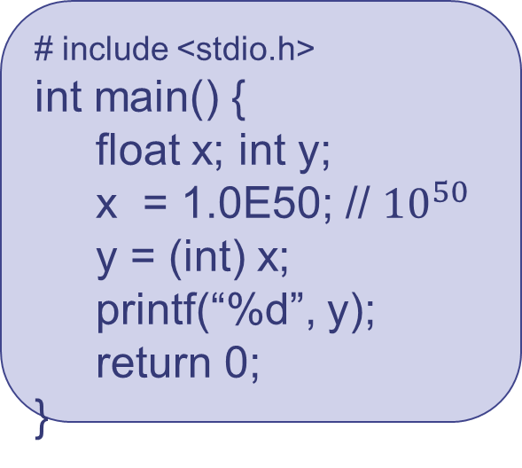
float to int type conversion (not ok!)
The floating point number 1E50 is too large to fit in an integer box.
float is a larger box, int is a smaller box. Assigning a float to an int may lead to loss of information and unexpected values.
# include <stdio.h>
int main() {
float x; int y;
x = 1.0E50; // ${10}^{50}$
y = (int) x;
printf(“%d”, y);
return 0;
}
Output:
-2184748364
Careful when converting from a ‘larger’ type to ‘smaller’ type. Undefined.

Slide 17
int to float (take care!)
# include <stdio.h>
int main() {
int y;
y = 1000001;
printf(“%f”, (float) y);
return 0; }
Output:
1000001.000000
Result is correct
# include <stdio.h>
int main() {
int y;
y = 10000009;
printf(“%f\n”, (float) y);
printf(“ %d”, y);
return 0; }
Output:
10000008.000000
10000009
Result is not correct.
Information is lost.

Slide 18
temp_conversion.c
Microprocessors represent real numbers using finite precision, i.e., using limited number of digits after decimal point.
Typically uses scientific notation:
12.3456789 represented as 1.23456789E+1. Bit more later.
# include <stdio.h>
int main() {
float Centigrades;
float F;
Centigrades=50;
F = ((9*Centigrades)/5) + 32;
printf(“The temperature “);
printf( “%f”, Centigrades);
printf(“Celsius equals”);
printf(“%f”, F);
printf(“Fahrenheit”);
return 0;
}
“%f” signifes that the corresponding variable is to be printed as a real number in decimal notation.
C
50.000
F
??
122.0000
??
??
Compile and Run
The temperature
50.000000
Celsius equals
122.000000
Fahrenheit
%

Slide 19
char data type in C
Basic facts
Characters in C are encoded as numbers using the ASCII encoding
ASCII : American Standard Code for Information Interchange
Encodings of some of the common characters:
'A' is 65, 'B' is 66, 'C' is 67 ... 'Z' is 90
'a' is 97, 'b' is 98 ... 'z' is 122
'0' is 48, '1' is 49 ... '9' is 57

Slide 20
char data type in C
Range: 0 to 255
You should NOT try to remember ASCII values
Encoding/programming languages provide alternatives to use them
C treats characters as integers corresponding to their ASCII value.
While displaying with %c placeholder, the ASCII value is converted to its corresponding character.

Slide 21
char data type in C
Interconversion between character and integer datatypes can be exploited to write programs.
printf("%d\n", 'A');
printf("%d\n", '7');
printf("%c\n", 70);
printf("%c\n", 321);
Output:
65
55
F
321 is outside range! What do you think will be the output of
printf("%c\n",321);
Try it out

Slide 22
char data type in C
Interconversion between character and integer datatypes can be exploited to write programs.
printf("%c\n", ‘C’+5);
printf("%c\n", ‘D’ - ‘A’ + ‘a’ );
printf("%d\n", ‘3’ + 2);
Output:
H
d
53
Placeholder determines the output.
Use with caution.
Avoid arithmetic operation such as * and / on characters.
Common Mistake: Incorrect data type of placeholder.

